Slide 1

Problem Set #2

Slide 2
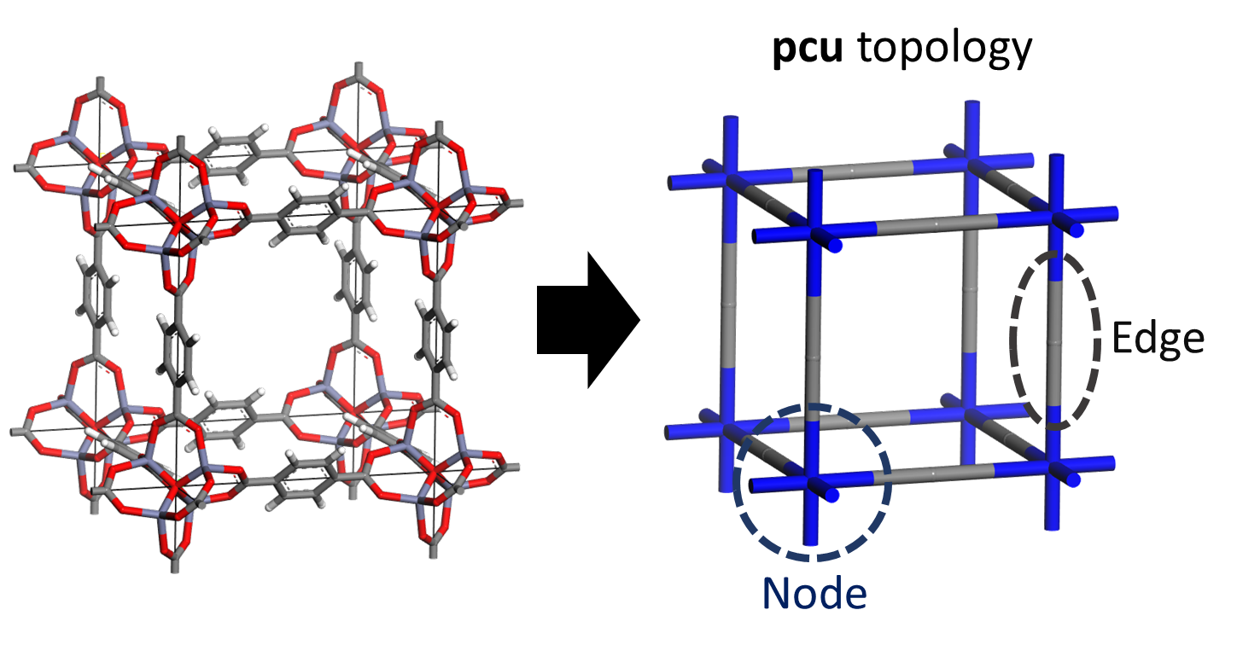
Problem Set #2
In this problem set, we will predict methane working capacities for MOFs
MOF stands for “Metal-organic framework” and is part of porous materials
Here are short explanations about the data given for the problem set#2
MOFs are named after their topology and building blocks(nodes+edge)
Ex) pcu+N127+E134

Slide 3
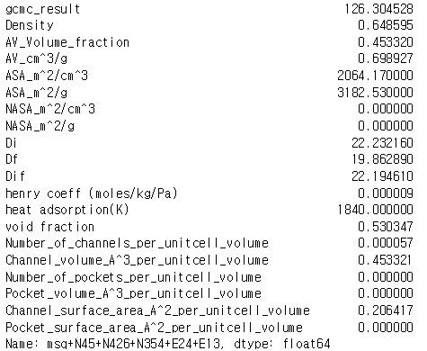

Problem Set #2
In this problem set, we will use two different representation method for MOFs
First, we will use zeo++ data to represent MOF (part a)
Ex) MOF “msq+N45+N426+N354+E24+E13” will be represented as below
Second, we will use constitution data itself to represent MOF (part b)
Ex) MOF “msq+N45+N426+N354+E24+E13” will be represented as
[1882, 3, 1342, 979, 1235, 176]

Slide 4
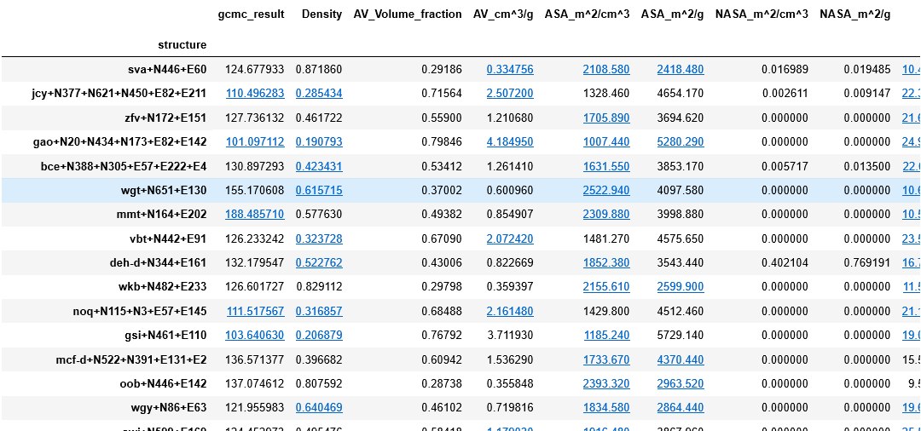
Problem Set #2
In the folder [Problem Set2], you can find out “Problem_set2_zeo++_representation.ipynb” and “Zeo_gcmc.csv”
"Zeo_gcmc.csv”
Will predict working capacity of the material with the feature data
Working capacity data
Features of the material
Material (MOF)
Representation

Slide 5
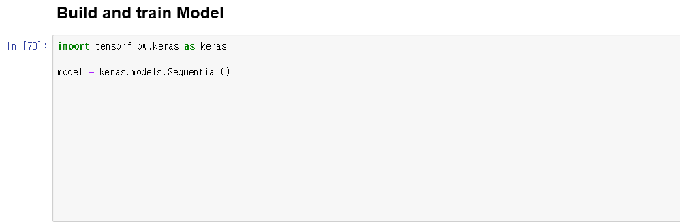
Problem Set #2
Part(a) : Fill in the blanks of “Build and train Model” part
Continue executing “Problem_set2_zeo++_representation.ipynb” till “Build and train model” part. Below is where you should fill in.
Execute rest of the .ipynb file
Fill in.
A. Build 2 hidden layers (neuron 1000,256)
and 1 output layer
use the activation of “relu” for all layers
B. Compile with optimizer= "adam”, loss = “mse”
and learning rate = 0.0001
C. Train model with train dataset.
Use batch size of 32 and epochs of 4

Slide 6
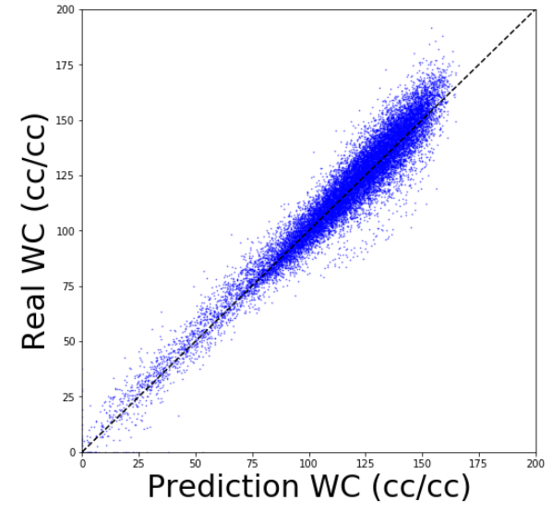
Problem Set #2
If you got the picture below at the end of “Prolbem_set2_zeo++_representation.ipynb, you succeeded for part (a)

Slide 7
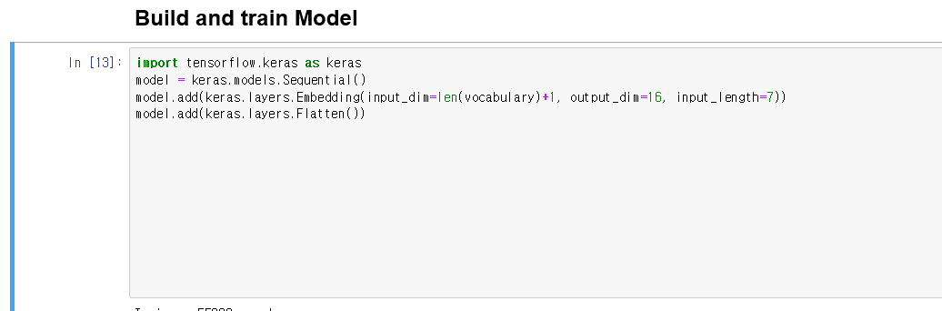
Problem Set #2
In Part(a), we predicted WC of MOF with zeo++ data.
In Part(b), we will predict working capacity(CH4) of MOF with different representation method using “topology and constituents”
In folder [Problem set2], you can see “MOF_wc_data.csv” and “Problem_set2_constitution_representation.ipynb” files
Execute till “Build and train Model” part
Part(b) : Fill in the blanks of “Build and train Model” of the .ipynb file
Fill in.
A. Build 2 hidden layers (neuron 64, 32)
and 1 output layer
use the activation of “relu” for all layers
B. Compile with optimizer= "adam”, loss = “mse”
C. Train model with train dataset.
Use batch size of 32 and epochs of 4

Slide 8
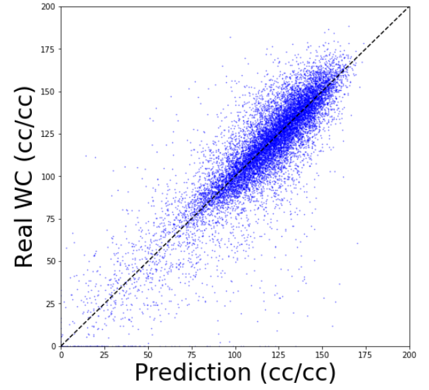
Problem Set #2
If you got the picture below at the end of “Problem_set2_constitution_representation.ipynb”, you succeeded for part (b)

